Slide 1
Burkholderia Pseudomallei
Name
Institution
Date

Slide 2
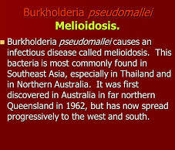

Slide 3
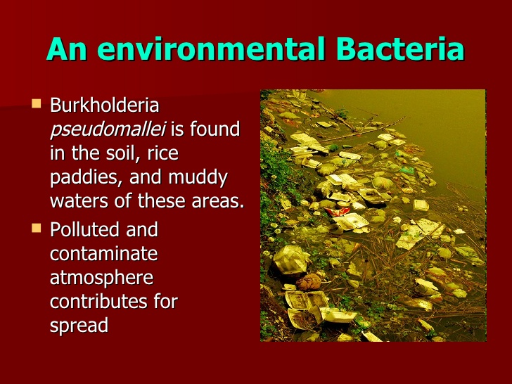
Natural habitat/Environment
Soil
Rice paddies as well as
Stagnant waters

Slide 4
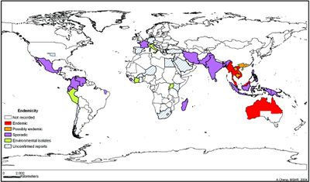
Region where it can be found.
Tropical and subtropical regions;
Thailand, Malaysia, Singapore and Northern Australia
Southeaast Asia, South Asia and China
Papua Guinea and New Caledonia

Slide 5
Reservoir
the soil
contaminated water
predominant during rainy season

Slide 6
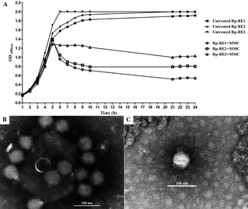
Host Range
dependant on the phages
isolation of a podovirus

Slide 7
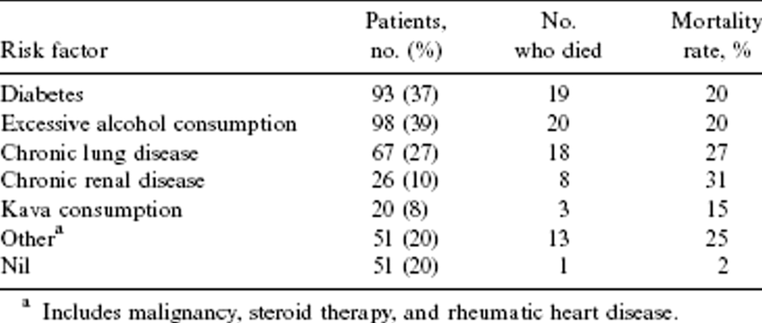
Predisposing & Occupational Risks, Disease? Infectious Dose?
Predisposing risks; smokers, diabetic patients, alcohol abusers, chronic renal and lung diseases, liver infections, thalassemia, kava consumption and cancer
Occupational risks; people working or staying in Southeast Asia and Northern Australia as well as other
Infectious dose- 10 colony forming units

Slide 8
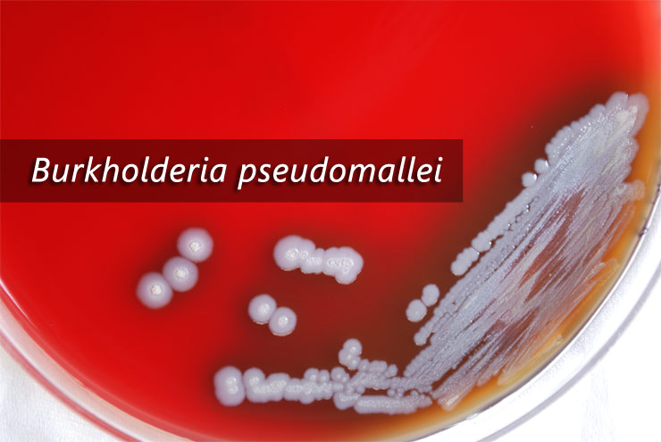
Mode of transmission?
soil and surface waters
inhaling dust or water droplets

